Slide 1
Artificial intelligent lab
Prepare by
Zobeda hatif naji
Computer department
Engineering college

Slide 2
Out line
ELEMENT-BY-ELEMENT OPERATIONS
Tabel
Tutorial

Slide 3
ELEMENT-BY-ELEMENT OPERATIONS
it was shown that when the regular symbols for multiplication and division(* and / ) are used with arrays, the mathematical operations follow
the rules of linear algebra. There are, however, many situations that require
element-by-element operations. These operations are carried out on each of the
elements of the array (or arrays). Addition and subtraction are by definition
already element-by-element operations, since when two arrays are added (or subtracted)
the operation is executed with the elements that are in the same position in
the arrays. Element-by-element operations can be done only with arrays of the
same siZe.

Slide 4
Table
Element-by-element multiplication, division, or exponentiation of two vectors or matrices is entered in MATLAB by typing a period in front of the arithmetic operator.

Slide 5
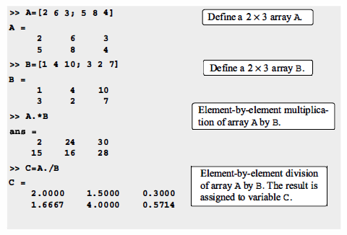
Tutorial

Slide 6
Tutorial

Slide 7
Tutorial
Element-by-element calculations are very useful for calculating the value of a function at many values of its argument. This is done by first defining a vector that contains values of the independent variable, and then using this vector in element-by-element computations to create a vector in which each element is the corresponding
value of the function. One example is:

